Slide 1

Software Standards
Mark Horneff
Senior Account Executive
Sega Europe
E-Mail:Horneffm@soe.sega.co.uk

Slide 2
Overview
Introduction
  Topics to be covered
    Naming Conventions
    Logo Requirements
    Controller Set-up
      Soft Reset
      Single/Multi player Port Allocation
      Controller Removal
    Visual Memory
      Saving procedures for the VM
      Executing Save Messages
      Memory Control Screen

Slide 3
Introduction
Indicators
  There are four indicators of standards documented in this guide:
      Required
      Recommended
      Standardised
      prohibited
    The above indicators apply both to the Sega Brand trademark and to Third-party trademarks.

Slide 4
Naming Conventions

Slide 5
Naming Conventions
  English Terms
      L Trigger
      R Trigger
      Analogue Thumb Stick
      Direction Pad
      Start Button
      Y Button
      X Button
      B Button
      A Button
      VM memory card
      VM Memory units

Slide 6
Naming Conventions
  English Terms (official terms)
      Visual Memory/VM
      Vibration Pack
      Arcade Stick
      Controller
      Race Controller
      Dreamcast Gun
      Keyboard
      Scart Cable

Slide 7
Naming Conventions
  English (non official terms)
      Control Deck
      Controller Sockets A-B-C-D
      Power Indicator Light
      Power button
      Power Indicator Light
      Ac Power Supply Connection Port
      AV MULTI OUT connector
      VIDEO OUT output (yellow)
      R AUDIO OUT output (red)
      L AUDIO OUT output (white)
      SERIAL I/O port
      Modem wire

Slide 8
Logos

Slide 9
Logos
Required
      When using a software library provided by another company, that company's logo and trade name must be displayed at the specified location.
      For more details, see the following table and its accompanying text

Slide 10
Logos

Slide 11
Logos
(3)-The logo is required to appear in the “Before game start” sequences.

Slide 12

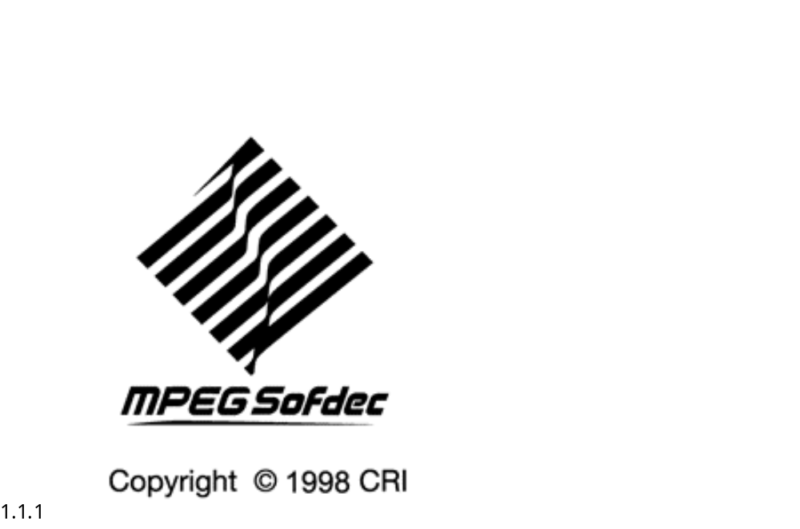
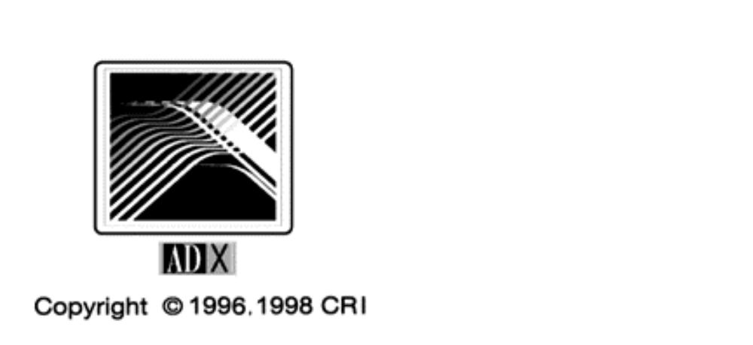
Logos
  Sample Logos
        Availible at HTTP://dreamstyle.sega.co.uk

Slide 13
Controller Set-up

Slide 14
Controller Set-up
  Controller Functions
    Menu Navigation-points to remember
    Required
      A button = Accept (perform)
      B button to Cancel (reject)
      This is always assumed to be the default configuration
    Recommended
      First Allocate the A and B buttons then X and Y
      Set buttons to act when pressed

Slide 15
Controller Set-up
  Soft Reset
      The Dreamcast does not include a hardware RESET button, so the console can be reset by using a soft reset function or by turning the power off and on.
      A soft reset should take the player back to the title screen and then to the boot rom.
    Required
      A soft reset must occur when the START Button is pressed while the A + B + X +Y buttons are all held down together
      Applications must make soft resets possible

Slide 16
Controller Set-up
  Controllers and Control Ports
    Minimum Controller Functions for a Sega Dreamcast Title
      The A/B and START buttons
      The directional pad
      Functions not guaranteed to be present are:
      The X/Y buttons of the standard controller
      The L/R trigger
      The analogue stick.

Slide 17
Controller Set-up
  Single-User and Multi-User Applications
    Required
      It must be possible to start and operate the game from any of the four front-panel ports
    Recommended
      When a game has more than one player, assigning ports may be performed as the developer sees fit
      All ports must be operational

Slide 18
Controller Set-up
  Checking Control Ports in Mid-Play
    Required
      Your application must test the ports frequently in the title loop before starting a game
  Removing a Controller
    Required
      When a controller is removed application should pause and display an onscreen warning

Slide 19
Controller Set-up
  When a Controller is Removed and then Reconnected to the Same Port
    Recommended
      If a controller is removed from a port that has been used and a controller is reconnected to the same port, input must be resumed
      Reconnecting a different controller is permitted
      Both the controller and its external memory must be recognised

Slide 20
Controller Set-up
  Reconnecting a Controller to a Different Port During the Game
    Required
      In an application in which single player uses a single controller, play is not resumed
    Recommended
      In the case of single-user, multi-controller game, input should be resumed even on a different port, as long as the controller is compatible

Slide 21
VM Procedures

Slide 22
Visual Memory
    Required
      The correct naming convention in Europe is VM not VMU
      If a VM device is present, the application must make use of the card to save game data
      The save file for a Dreamcast application must always be registered.
      Create a file name that is easily recognisable

Slide 23
Visual Memory
  Saving procedures for the VM
    Applications that have a memory card selection screen when saving
      In this case, the user selects the memory card at each save.
    Non-revisable Autosaves
      Once a memory card has been selected, that memory card is used throughout the whole game

Slide 24
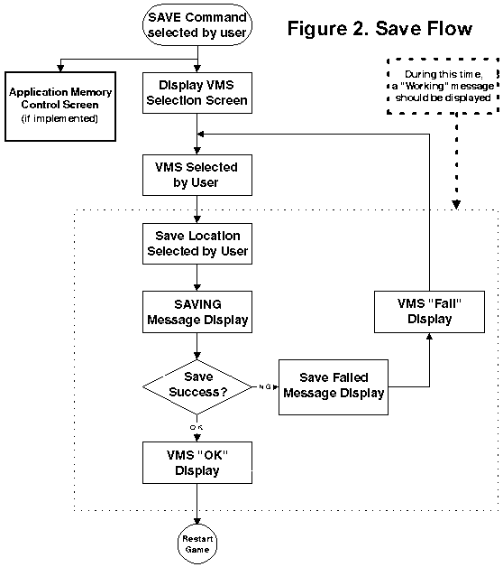
Visual Memory
Save flow for applications using a VM select screen before each Save

Slide 25
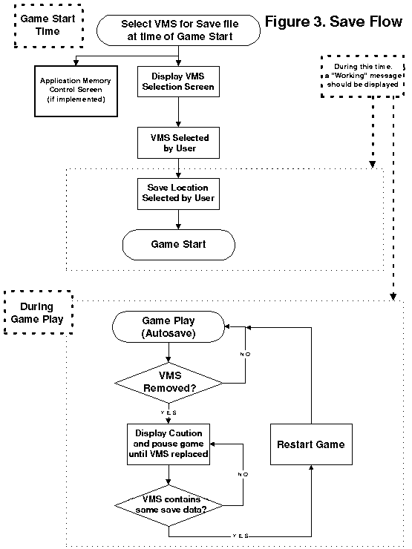
Visual Memory
Save flow for applications using a save file that is selected when starting the game, and the save file is overwritten during the game.

Slide 26
Visual Memory
  Procedures for saving on a VM
    Required
      Make the memory card inserted in either expansion socket selectable
      When the user selects a memory card, the user’s selection should be clearly indicated
      Hot swapping of memory cards must be supported

Slide 27
Visual Memory
Executing Save Messages
    Required
      A caution message such as “Saving, do not turn Power off” should be displayed
      When a save operation fails, “Save could not complete correctly” should be displayed
      “A file with the same name already exists. OK to overwrite? (YES/NO)”
      When no memory card is installed “A memory card with at least xx blocks of space is required. Cancel save? (YES/NO)”

Slide 28
Visual Memory
  Executing Save Messages- contd
    Required
      When there is not enough free space “There are not enough free memory blocks. XX empty blocks are required for saving. Cancel save? (YES/NO)”
      When a warning message is displayed once, it is not necessary to display the message again
      After displaying one of the warning messages make it possible to continue to game

Slide 29
Visual Memory
  Memory Control Screen
    Required
      The commands “Delete all files” and “Initialise” cannot be displayed
  Loading Saved Files
    Required
      When loading a save file, either display a message such as “Loading...” or indicate to the user in some other way that the save file is loading

Slide 30
European Systems
    Required
      Software designed for operation on European systems should be compatible with a 21-pin RGB cable (15kHz RGB output mode)
      In France for example all Dreamcasts are supplied with 21-pin RGB cable (SCART)
      For this reason, unless 15kHz RGB is consciously supported via software, it may not function correctly on Dreamcasts using this configuration

Slide 31
European Systems
    If you have questions about technical problems regarding Dreamcast development in Europe or any of the Dreamcast standards, you can find answers at:
      e-mail: edts@soe.sega.co.uk
    …or Developer Technical Support website at:
      http://www.dts.sega.com/NextGen.

